Slide 1
2021 Awards
Annual Conference

Slide 2
Excellence in GIS Award
Each year, IGIC honors outstanding projects through our Excellence in GIS Award. This award recognizes organizations in six different categories for their use of geospatial technology to improve our world. Eligible projects are those developed, completed, or that reached a significant milestone in 2020 or 2021.

Slide 3
Excellence in GIS - County Office of the Monroe County Surveyor
Challenge:
Adolescents in Greene, Monroe, and Owen Counties are part of what is referred to as Safe Place Communities. This is a national designation that requires communities to recruit nonprofits, government agencies, and private companies to make themselves available to children, and particularly adolescents, in need of a safe place. These buildings display a large, yellow street type sign displaying a standardized logo. When a youth feels they are not safe or welcome at home, they can enter one of these organizations, ask for a Safe Place, and quickly be seen by an on-call social services professional. GIS can facilitate social services meeting these adolescents where they are at in some cases, literally. Initially identified areas of need were barriers in portraying Safe Place locations correctly, current information on those locations and workflow to update them, geographic discrepancies in location density, lack of age-appropriate resources for Safe Place service population. All needs were addressed with varying efficacy. Existing assets included an overall community knowledge of what Safe Place is, local businesses willing to be involved, a widespread transit system that serves as a mobile safe place, and a Safe Place Coordinator with the Monroe County Youth Services Bureau.

Slide 4
Excellence in GIS - County Office of the Monroe County Surveyor
Result:
The foundational goal of the project was to set up an information system that is correct, able to change with innovation, and depends on a working relationship with other organizations. Those have been achieved. Data management tools are being created, so non-GIS users are able to edit data in one place that is both presentable in GIS and non-GIS settings. The accuracy of the location information and coordinates are current and are now easily available to the public as a means for information access and education. Community engagement serves as a quality control tool to identify archaic data, particularly location information. The target population now has significantly easier access to the information with the locator tool available through a QR code. This meets the need of having age-appropriate resources and will serve as a foundation for creative measures in partnership with helping professionals. Community members able to share this easily through social media, and they are able to learn about Safe Place from any base level of knowledge. Educators and social service workers are better able to educate, case manage, and provide resources to youth.

Slide 5
Excellence in GIS - County Office of the Monroe County Surveyor

Slide 6
Excellence in GIS - County Office of the Monroe County Surveyor
Award Team:
Jared Eichmiller - Office of the Monroe County Surveyor

Slide 7
Excellence in GIS - Small Community (population under 50, 000) - City of Hobart
Challenge:
There were 10 Key Challenges the City of Hobart was attempting to address in 2020 and 2021 following the development of a GIS roadmap in 2019. The City wanted to:
Effectively Promote the Welfare of its Citizens
Empower Stakeholders and Residents with GIS Tools and Information
Educate Stakeholders and Residents about the Uses and Benefits of Location Intelligence
Provide Open and Transparent Government and Public Service
Streamline City Operations and Improve Efficiency
Improve Digital Data Accuracy and Data Reliability
Promote Economic Growth and Development with Visualization Capabilities
Quantify the Value and Benefits of GIS Technology
Introduce Advanced Geospatial Technology 3D Modeling
Establish Lasting, Sustainable GIS Governance

Slide 8
Excellence in GIS - Small Community (population under 50, 000) - City of Hobart
Result:
Welfare - ArcGIS Hub encourages citizen engagement by making GIS accessible and easy to use.
Empowerment - ArcGIS Hub provides a one-stop GIS shop with a variety of tools.
Education - Hobarts GIS needs, opportunities, and recommendations were outlined in a multi-year roadmap.
Open government - ArcGIS Hub offers multiple public-facing apps, story maps, and open data.
Efficiency - ArcGIS Hub streamlines access to GIS by organizing GIS tools and information in a single location. Hobart adheres to industry standards when designing its databases, allowing information to be captured and disseminated clearly and effectively.
Data - Hobart has adopted data standards such as the LGIM and Esri’s Utility Network model. Hobart invested significant effort into improving the accuracy of GIS assets, reconciling issues in GIS data with other sources.
Development - ArcGIS Hub provides simple GIS access to developers and planners through apps and open data.
Benefits - Hobart has identified 16 areas for GIS ROI.
3D - Hobart is modeling the City’s buildings in 3D.10.Governance - Hobart is following the recommendations in its GIS roadmap to ensure sustainable GIS governance.

Slide 9
Excellence in GIS - Small Community (population under 50, 000) - City of Hobart

Slide 10
Excellence in GIS - Small Community (population under 50, 000) - City of Hobart
Award Team:
Rives Deuterman - Geographic Technologies Group
Tim Kingsman - The City of Hobart, IN

Slide 11
Excellence in GIS - Large Community (population over 50, 000) - City of Carmel
Challenge:
2021 Carmel Marathon Mapping: Map Data Consolidation & Operational Real-time Display for EOC
The 11th Annual Carmel Marathon Weekend on April 3, 2021, marked the event’s return to live racing. Nearly 3,000 people from 40 states crossed the finish line. Initially the 2021 Carmel Marathon Mapping project began as a consolidation of many, many resources into a single resource "paper map" to be distributed among public safety and marathon volunteers alike. The initial resources included marathon route maps (5 separate routes) showing water and first aid stations, Carmel Police maps showing street closures, barricade placements and personnel shifts and Carmel Fire maps showing EMS locations and safety stations. The second part of the 2021 Carmel Marathon Mapping Project involved displaying a real time map of the marathon on a large display monitor in the EOC (Emergency Operations Center.) The display should show first and foremost the progress of the runners in the marathon. It should also show the locations of public safety vehicles utilizing existing AVL, but only those vehicles directly involved in the event. If possible, the display should also track vehicles from additional and perhaps outside agencies.

Slide 12
Excellence in GIS - Large Community (population over 50, 000) - City of Carmel
Result:
2021 Carmel Marathon Mapping: Map Data Consolidation & Operational Real-time Display for EOC
The map consolidation took many, many hours of GIS editing utilizing ArcGIS Pro software from ESRI. Luckily, the Carmel GIS Department has created maps for the Marathon for the past several years, so the majority of features and layers have all been previously defined. The routes, water and first aid station locations are provided by the marathon group and not only change every year, but new races and routes are be added. The Carmel Police Department, CPD, provides road closure information, barricade placements and staff assignments at various locations along the route. The Carmel Fire Department, CFD, provides EMS and safety station locations and staffing information. The resulting map is meant to provide a "one-stop shop" for information about the event. The real time display in the EOC was a dashboard Kurt created as a web app. The marathon map was used as the basemap, and then actual vehicle locations were added utilizing existing AVL technology (Cradle Point) in the CPD, CFD and EMS vehicles. The streaming data was then resolved into the map using GeoEvent Server software from ESRI. By defining filters that focused on the data and the event, Kurt was able to boost real-time monitoring and response rate. The race progress was tracked with ArcGIS Tracker. The Tracker software was loaded on a cell phone and carried by a CPD motorcycle officer leading the race.

Slide 13
Excellence in GIS - Large Community (population over 50, 000) - City of Carmel

Slide 14
Excellence in GIS - Large Community (population over 50, 000) - City of Carmel
Award Team:
Theresa Krueskamp – City of Carmel
Kurt Shanayda – City of Carmel

Slide 15
Special Achievement in GIS Award
This award recognizes special geospatial projects developed through teamwork that demonstrate commitment to working with others in the Indiana GIS community toward a common goal, while performing important, often pioneering work, to create an outstanding information resource. Eligible projects are those developed, completed, or that reached a significant milestone in 2020 or 2021.

Slide 16
Special Achievement - Indiana Geographic Information Office
Challenge:
Since 2008, the Indiana Geographic Information Office (GIO) has been working towards creating statewide datasets for address points, street centerlines, parcels, and administrative boundaries. In 2020, the GIO worked with the Polis Center at IUPUI to improve the process, including data cleanup and data augmentation. The project included the development of a new updated statewide geocoder using the latest data available. Unlike past years, the four data layers were made available for download at both the state and county level. For the first time, the geocoder, including the underlying data and locators, was made available for download as well.

Slide 17
Special Achievement - Indiana Geographic Information Office
Result:
While the first county agreed to participate in 2008, it took until 2014 for all Indiana counties to participate in this effort. The latest Data Harvest , conducted in the second half of 2020, resulted in over 3.2 million address points, almost 3.6 million parcels, over half a million street centerlines and slightly more than 4 thousand administrative boundaries. That level of data was the result of the most comprehensive participation of counties sharing new data since 2008 with all 92 counties contributing parcels, address points, and streets, and 89 counties contributing boundaries. The team created a statewide geocoder available in both UTM and WGS84 spatial references. The geocoder is a composite locator composed of seven different locators using the Data Harvest’s statewide address points and street centerlines, along with the US Census Bureau’s 2020 Tiger edges for Indiana and surrounding states, ZIP code boundaries, and more. Finally, based on feedback, the Dashboard includes six statewide data tables from the Indiana Department of Local Government Finance (DLGF): parcel, land, improve, dwelling, building, and building detail. The statewide address points and parcels layers include a unique parcel identifier that can be used to augment the data with the DLGF real property data. Detailed documentation was developed for both the statewide datasets and the geocoder to document how the data was created, the data sources, and detail each field. The team is working on the 2021 Data Harvest and is working with IGIC to improve the overall process and provide additional value to local governments.

Slide 18
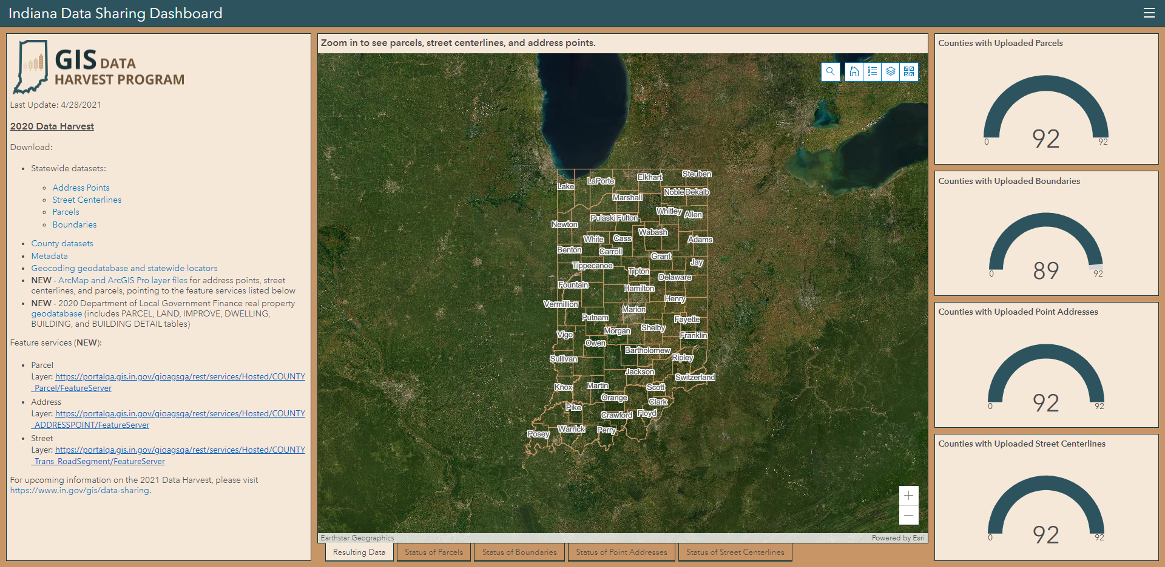
Excellence in GIS - County Office of the Monroe County Surveyor

Slide 19
Special Achievement - Indiana Geographic Information Office
Award Team:
Megan Compton – Indiana Geographic Information Office
Shaun Scholer – Indiana Geographic Information Office
Marianne Cardwell – Polis Center
Jim Sparks – Polis Center
Charline Avey – TechHow, Inc.

Slide 20
Special Achievement - Indianapolis Metropolitan Planning Organization
Challenge:
The Central Indiana Bike Amenity Map's goal is to crowdsource data from the Central Indiana bicyclist community regarding different amenity locations, including bike racks, bike share stations, park and ride facilities, bike shops, bike repair stations, recreational sites, bike lockers / secure bike parking, and Non-Commercial Public Restrooms. Users can input an address or manually zoom to a location to add an amenity, rate its condition, and provide any additional comments. An underlying layer on the map contains known existing bike amenities and infrastructure. This layer will be periodically updated with the crowdsourced data by the IMPO. The map will remain public so the bicycling community can also use the map to find amenities throughout the region.

Slide 21
Special Achievement - Indianapolis Metropolitan Planning Organization
Result:
This project resulted in a public map that contains public amenities and infrastructure for bicyclists in the Central Indiana community, which is comprised of Marion County and portions of the surrounding 8 counties. Additionally, the map collects the crowdsourced data that users have submitted, even prior to the update to the other layer. The IMPO is striving to continue to have people contributing to and utilizing the amenities map.

Slide 22
Special Achievement - Indianapolis Metropolitan Planning Organization

Slide 23
Special Achievement - Indianapolis Metropolitan Planning Organization
Award Team:
Danielle Gerlach - Indianapolis Metropolitan Planning Organization
Nicholas Badman - Indianapolis Metropolitan Planning Organization
James Rinehart - Formerly Indianapolis Metropolitan Planning Organization

Slide 24
2021 Awards
Annual Conference

