Slide 1
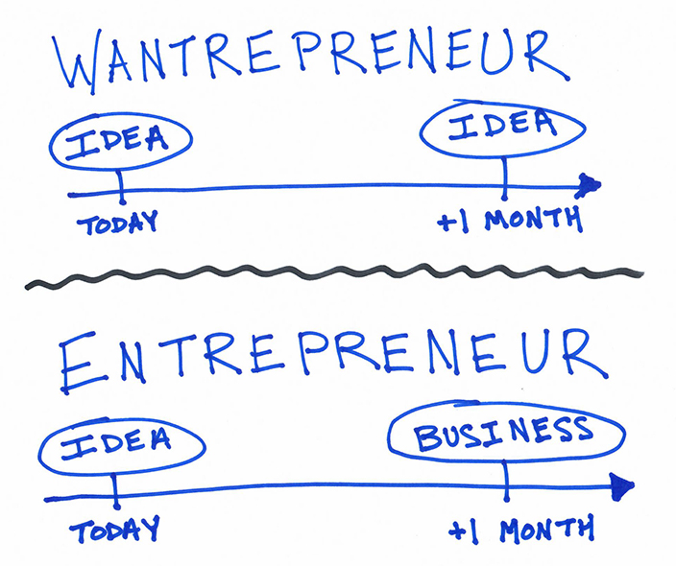
IGIC Webinar Series:
10/24/2019
Today’s Lineup:
Poll Questions
Have you ever considered being your own boss?
What do you see as the main barriers to becoming a GIS entrepreneur?
What assistance would push you over the edge to become a Hobbypreneur or Entrepreneur?
Starting a Business Presentation
Basic Startup Needs
Basic Startup Steps
Getting Business
Ongoing Needs
Starting a Business Discussion
Opportunities
Challenges

Slide 2
Have you ever considered being your own boss?
Poll Question
Have you ever considered being your own boss?
Wantrepreneur?
Hobbypreneur?
Entrepreneur?
Starting a Business Presentation
Basic Startup Needs
Basic Startup Steps
Getting Business
Ongoing Needs

Slide 3
Basic Startup Needs:
Wantrepreneur Hobbypreneur Entrepreneur
Nothing… keep your day job and thinking cap on.
Computer / Software
Access to Internet
Hobbypreneur Needs +
Health
Passion / Drive / Commitment
Poll Questions
What do you see as the main barriers to becoming a GIS entrepreneur?
What assistance would push you over the edge to become a Hobbypreneur or Entrepreneur?

Slide 4
Basic Startup Steps:
Wantrepreneur Hobbypreneur Entrepreneur
Nothing… but take notes for future.
Talk to a SCORE representative
Register Business Name with INBiz*
https://inbiz.in.gov/BOS/Home/Index
Obtain a Federal Tax ID Number (TIN).
https://www.irs.gov/businesses/small-businesses-self-employed/apply-for-an-employer-identification-number-ein-online
Talk to SCORE Advisor and (or) Mentor(s)
Find a lawyer and accountant that you can trust.
Let them file your business name and obtain TIN.
In the grand scheme, these two professionals won’t cost a fortune up front but will get started on a good foot.
* For Indiana-based companies.

Slide 5
Getting Business:
Who do you want to serve?
Local, State, and (or) Federal Government?
Commercial?
Higher Education?
Utilities?
Non-profits?
* For Indiana-based companies.

Slide 6
Getting Business:
Who do you want to serve? (cont.)
After this has been determined, talk to your mentor(s) and a SCORE representative to help prepare/review your business plan.
A business plan… yes… the dreaded business plan.
It doesn’t have to feared.
Think of it as a “dynamic” guidebook for you to refer to and revise overtime.
SCORE
https://www.score.org/?gclid=Cj0KCQjwl8XtBRDAARIsAKfwtxCwkodP3HKI7iRuUQ-90RwXVBrbTv853quX_YNVbkYtIXzQq8LuyWQaAphVEALw_wcB
SCORE Virtual Business
https://onlinexperiences.com/scripts/Server.nxp

Slide 7
Getting Business:
By this point, you are now able to market your company to the industries we mentioned earlier except for the Federal Government.
There are a few extra steps to position your company to market to the Federal Government.
Step 1 – Ask your mentor(s) and (or) SCORE representative if they feel you are ready to market to the Federal Government.
Step 2 – Obtain a Data Universal Number through the Data Universal Numbering System (DUNS)
Step 3 – Create an individual user account through System for Award Management (SAM) database and log in to register your entity.
Step 4 – Request a CAGE Code through the Defense Logistics Agency (DLA).
Step 5 – Request a meeting with your local U.S. Small Business Administration office.

Slide 8
Getting Business:
Here are some helpful links for doing market research for the federal government:
Contracting Assistance
https://www.sba.gov/federal-contracting/contracting-assistance-programs
USA Spending
https://www.usaspending.gov
FPDS
https://www.fpds.gov
Small Business Dynamic Search
https://web.sba.gov/pro-net/search/dsp_dsbs.cfm
Fed Biz Opps
https://www.fbo.gov/
Fed Connect
https://www.fedconnect.net/FedConnect/MemberHome/Dashboard.aspx
SCORE
https://www.score.org/?gclid=Cj0KCQjwl8XtBRDAARIsAKfwtxCwkodP3HKI7iRuUQ-90RwXVBrbTv853quX_YNVbkYtIXzQq8LuyWQaAphVEALw_wcB

Slide 9
Ongoing Needs:
Entrepreneur
Support System (Family, Friends, Mentors, etc.)
Don’t work in isolation.
Attempt to spend more time working “on” the Business instead of “in” the business.
Time Management
Freedom Grid
Activity | Me | Who? | Who? | Who?
Use this grid for 1 week. Jot down every activity you do, no matter how trivial. At the end of the week, review each activity and ask yourself,
“Am I the only one who can do this?”
“If it doesn’t have to be me, Who else can?”

Slide 10
Ongoing Needs:
Entrepreneur
Time and Intelligence Grid
ELIMINATE | RAISE
What activities should you eliminate? | What activities should you increase?
REDUCE | CREATE
What activities should you reduce? | Where should you invest more time?

Slide 11
For afterthoughts…
chris@39dn.com

