Slide 1
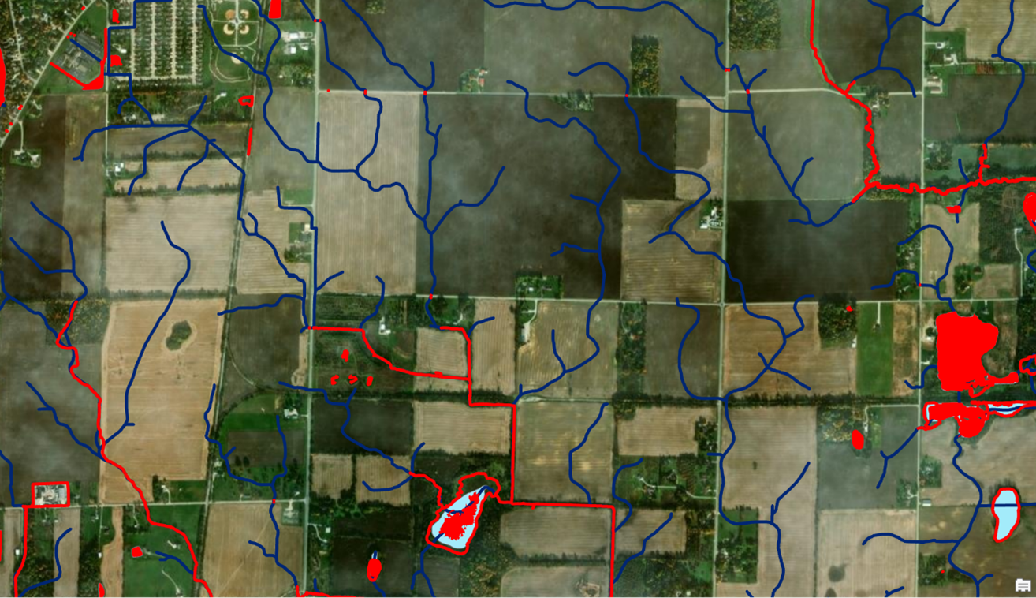
Forum Breakout Topic
Waters Initiatives
- National Hydrography Dataset
- Watershed Boundary Dataset
- Flood Plain Mapping
- Other????

Slide 2
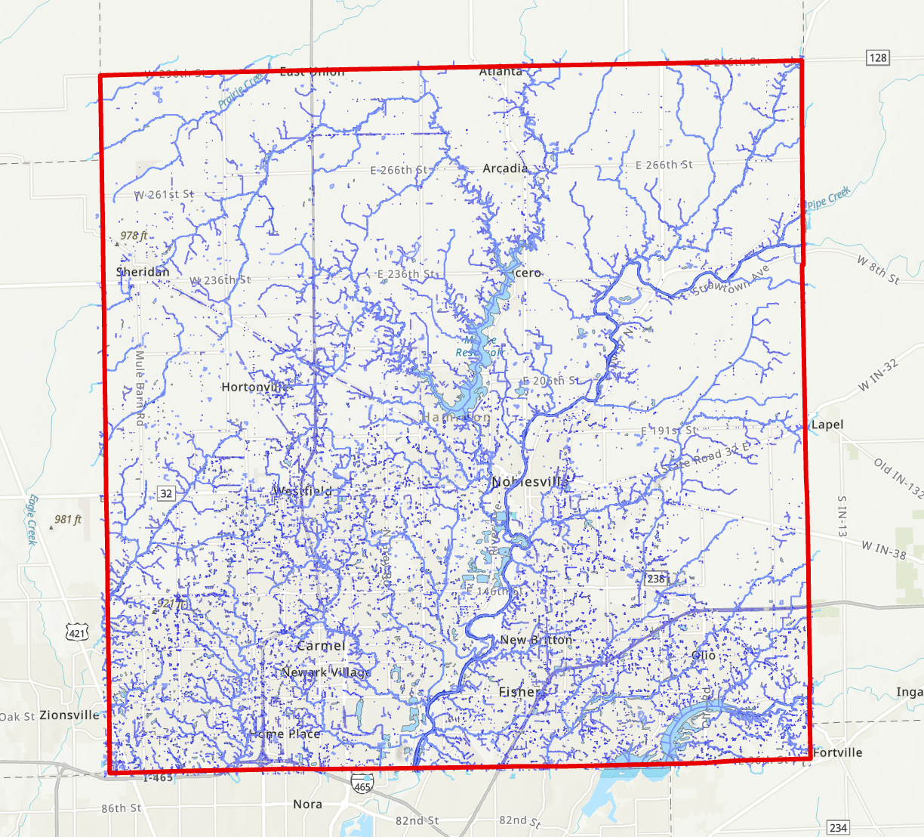
Hamilton Co, Existing Hydrography Mapping

Slide 3
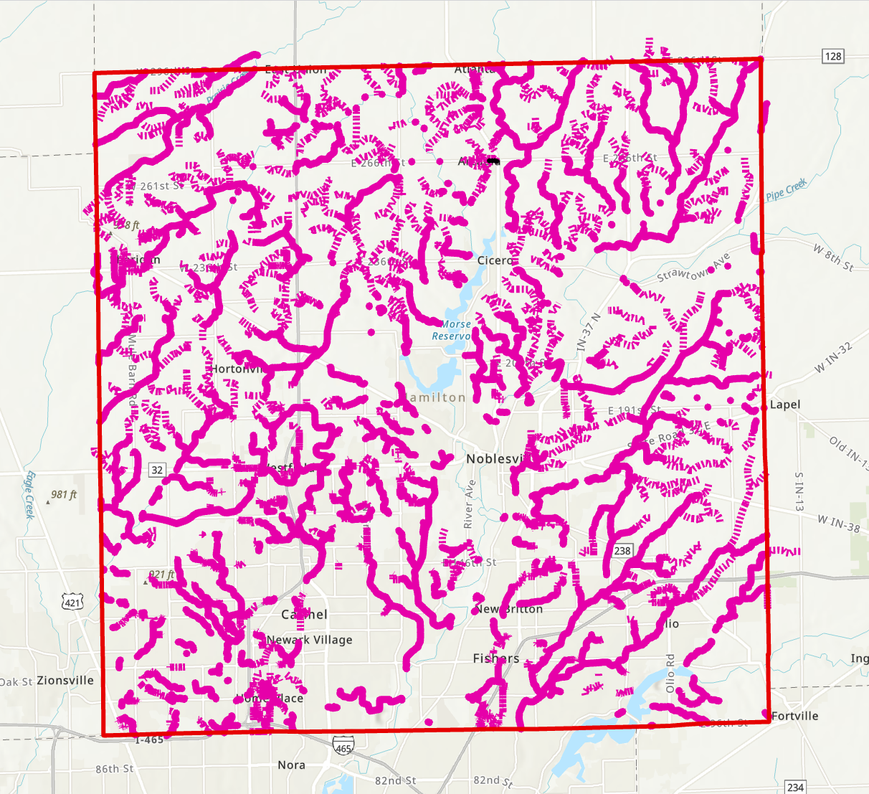
Hamilton Co, Existing Legal Drains Mapping
Other Local Government Hydro Features Inventoried and Mapped?
Farm Drain Tiles?
Culverts
Basins (Subdivision, Custom, …
Other?

Slide 4
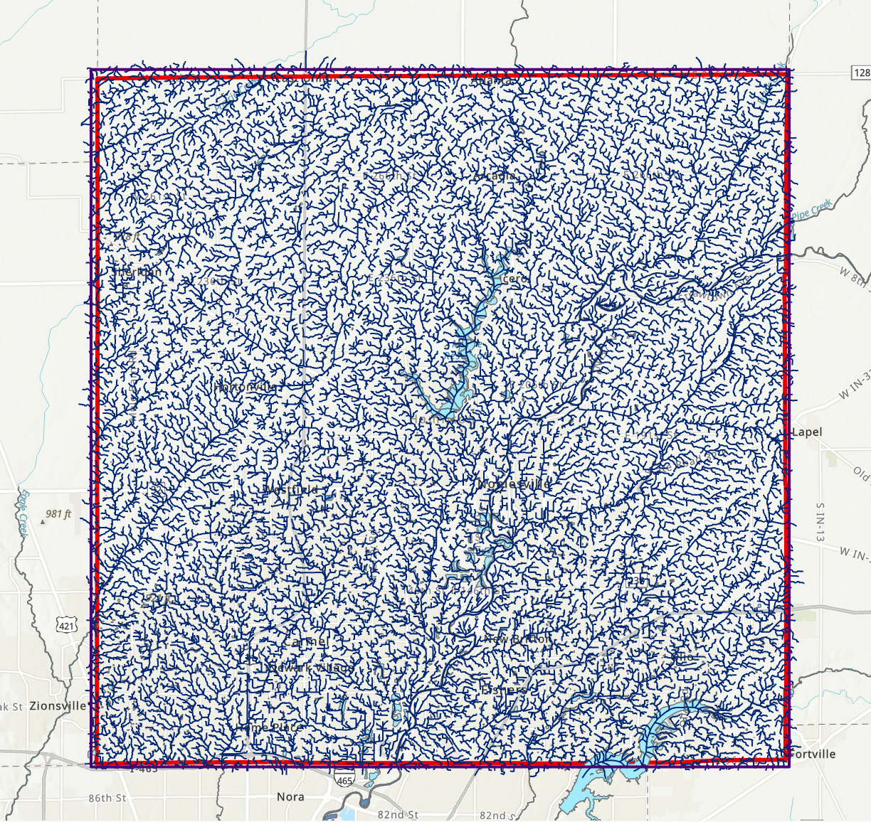
State of Indiana, Existing Hydrography Mapping (NHD)
Local-Resolution NHD Mapped from 2011-2014 QL3 Lidar and 1-Foot Pixel Orthoimagery
Scale 1”=100’
Resolution: 6 AC Catchment

Slide 5
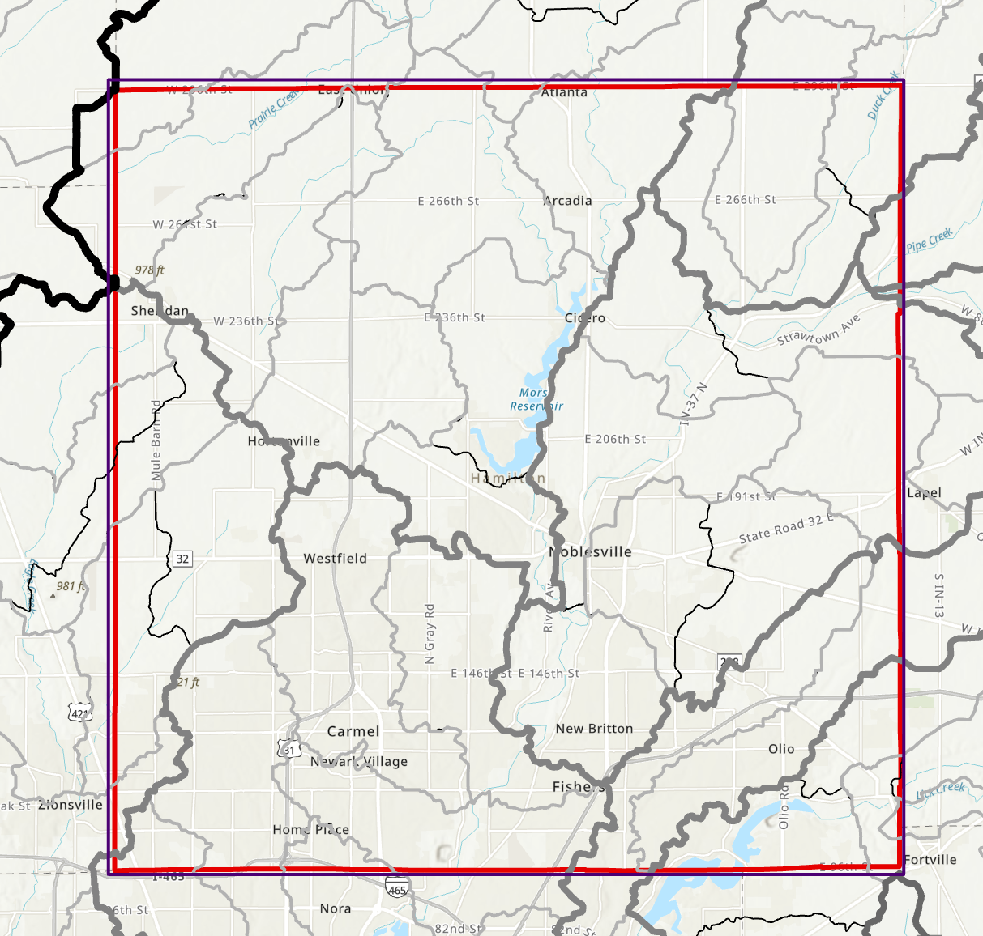
State of Indiana, Existing Hydrography Mapping (WBD)

Slide 6
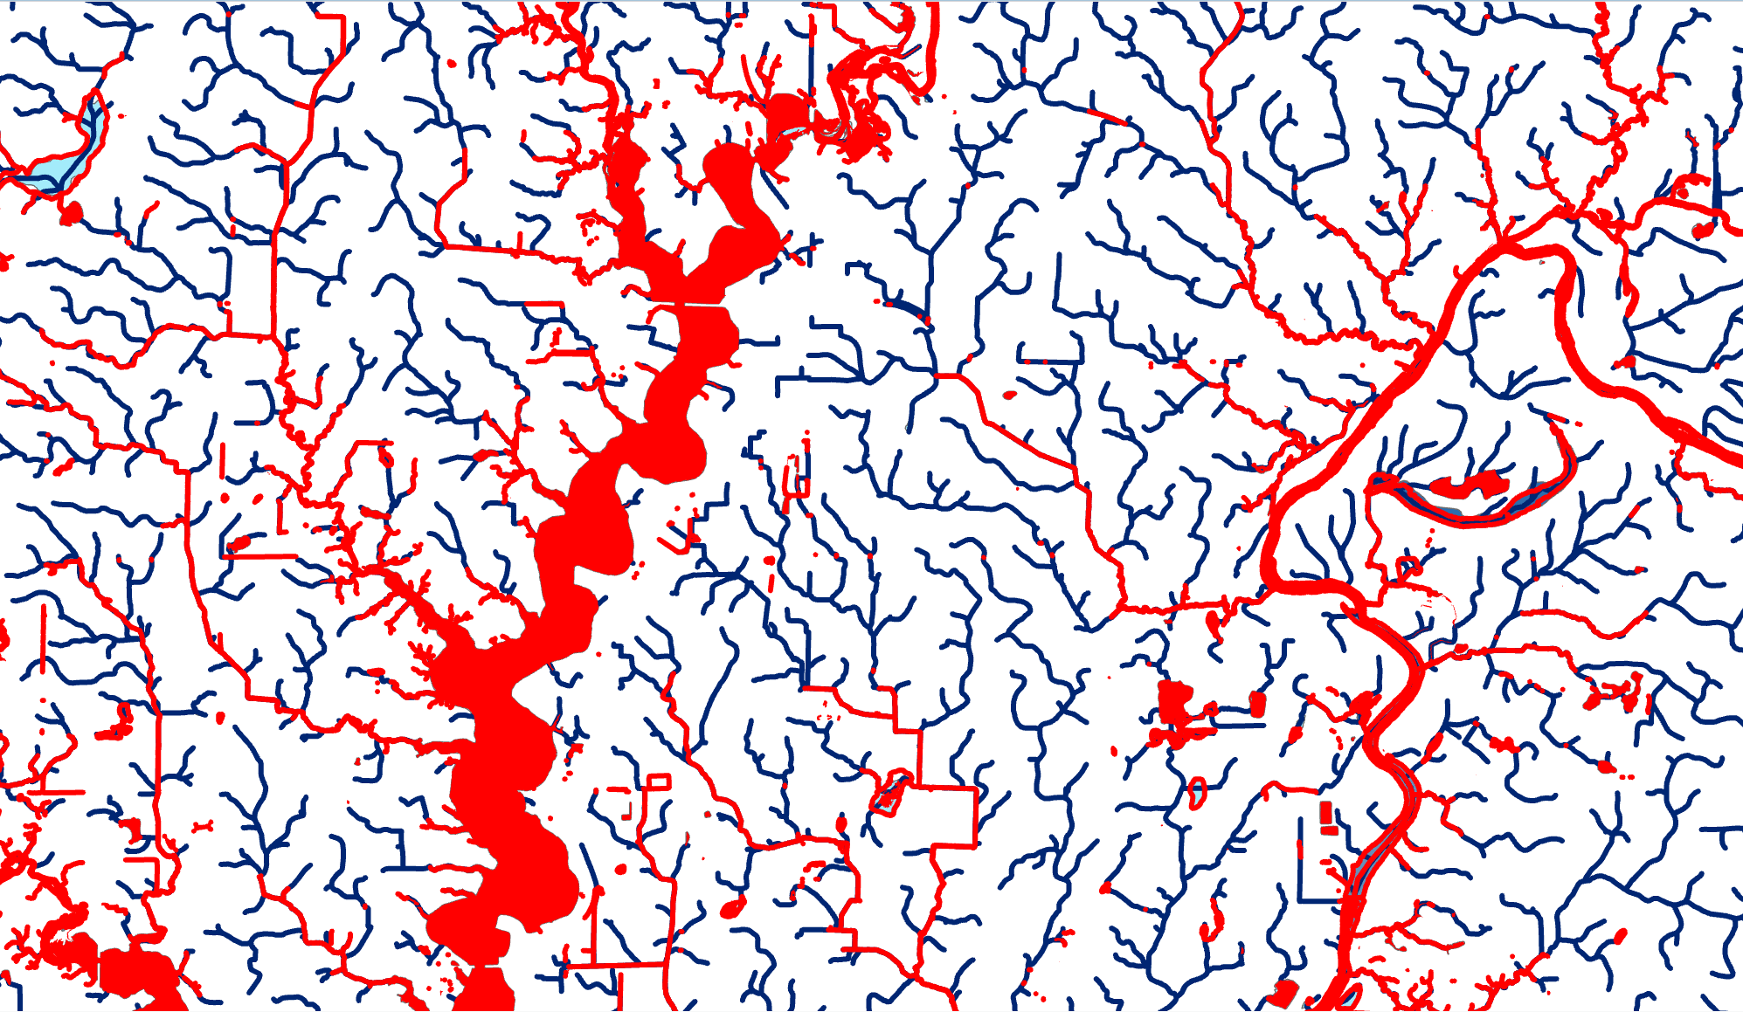
Comparing Existing State of Indiana NHD & Hamilton County Hydrography Mapping

Slide 7
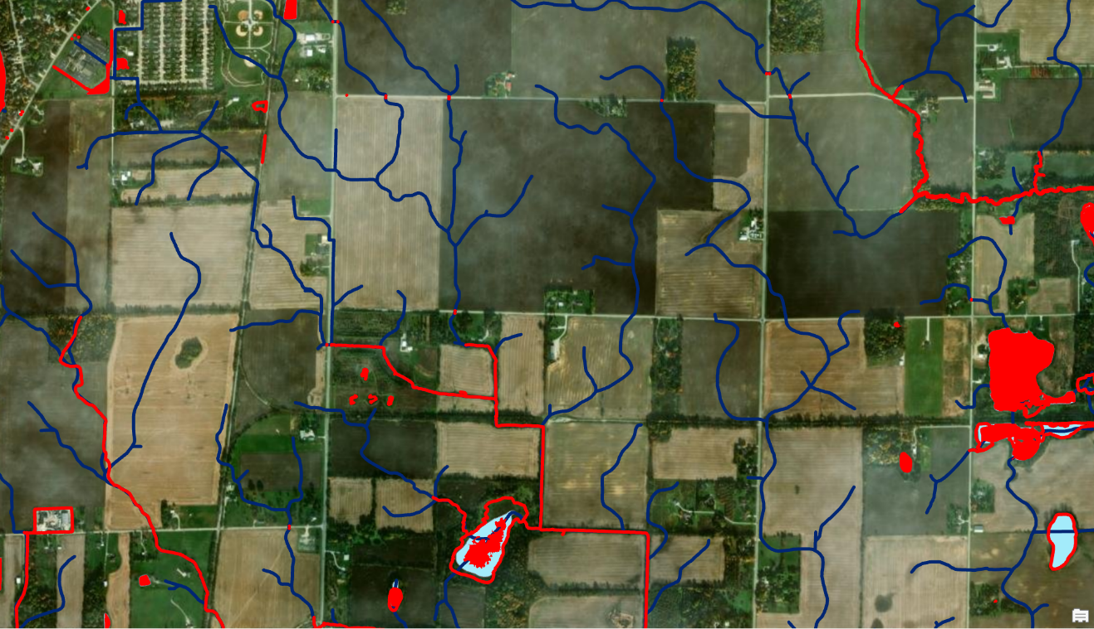
Comparing Existing State of Indiana NHD & Hamilton County Hydrography Mapping

Slide 8
Existing Indiana Statewide NHD/WBD Data and Sample County Hydrography Data (Hamilton County, IN)
IGIC Geospatial Coordinators Forum
September 20, 2023

Slide 9
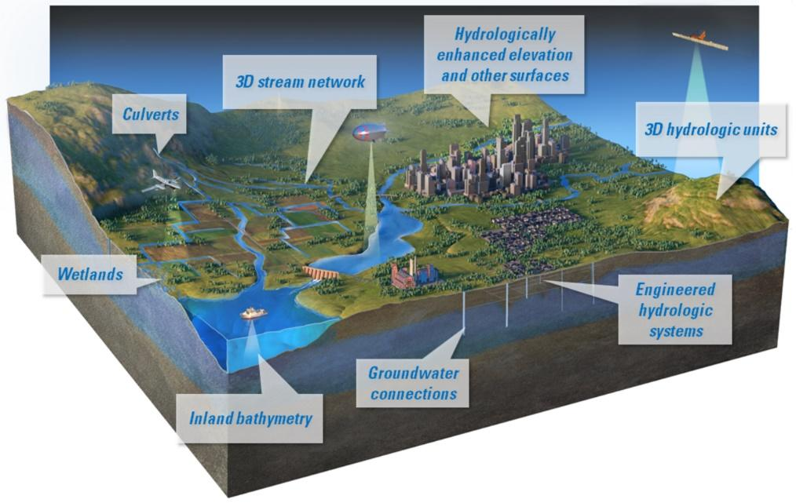
Existing NHD, WBD, and NWI Hydrography Mapping, and the Future of 3D Hydrography Mapping at USGS
IGIC Geospatial Coordinators Forum
September 20, 2023

Slide 10

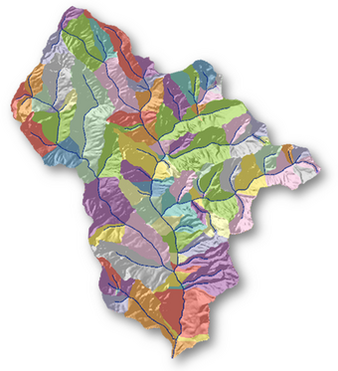
What is the status of the USGS NHD/WBD datasets?
The USGS has halted (FROZE) Maintenance and Stewardship activities on the USGS NDH In December 2023
The USGS will halt (FREEZE) Maintenance and Stewardship activities on the USGS WBD in June 2024
The USGS will publish a static [archive] copy of the NHD & WBD in the Fall of 2023
The USGS will use the static [archive] copy of the NHD to initially populate a 2D version of the 3DHP database in the Fall of 2023
As new EDH data is developed by HUC-8/10 areas, the USGS will validate and load these data into the 3DHP database replacing the legacy NHD data in that HUC

Slide 11
How does Indiana State, County and Local Governments Currently Use NHD/WBD data?
State:
GIO – Publish Indiana’s Local-Resolution NHD/WBD Layers for internal use, and on IndianaMap
IDNR – Active End-Users [and Stewards] of NHD/WBD
IDEM – Currently maintains their own Medium-Resolution NHD/WBD for tracking Event [point] data
County Example:
Hamilton County Surveyors Office - Do not use NHD/WBD due to its complexity. GIS uses hydrography layer generated in 2019 basemap update project. Surveyors Office uses custom layer showing mapping ~1,600 miles of Regulated Drains in the County.
City Example:
City of Carmel - Use counties 2019 basemap base layer stream and waterbody network. Integrated with storm sewer network to support MS4 and tied into CityWorks. Also used for annual FEMA reporting requirements.

Slide 12
What is the NWI?
The National Wetlands Inventory (NWI) is a program developed and maintained by the U.S. Fish and Wildlife Service (USFWS) to map, classify, and provide information on the status and trends of wetlands across the United States. It is considered the most comprehensive inventory of wetland resources in the country.
Key use cases and applications of the National Wetlands Inventory (NWI):
1. Wetland Conservation and Management: The NWI plays a crucial role in the conservation and management of wetland ecosystems
2. Regulatory Compliance: Wetlands are protected under various federal, state, and local regulations. NWI data helps ensure compliance with laws such as the Clean Water Act and the National Environmental Policy Act
3. Environmental Planning and Land Use: The NWI is used in land use planning and environmental impact assessments
4. Research and Science: The NWI data serves as a valuable resource for researchers, scientists, and educators studying wetland ecosystems
5. Habitat Management and Restoration: The NWI data assists in identifying and prioritizing areas for habitat management and restoration initiatives
6. Climate Change Adaptation: Wetlands play a crucial role in climate change mitigation and adaptation

Slide 13
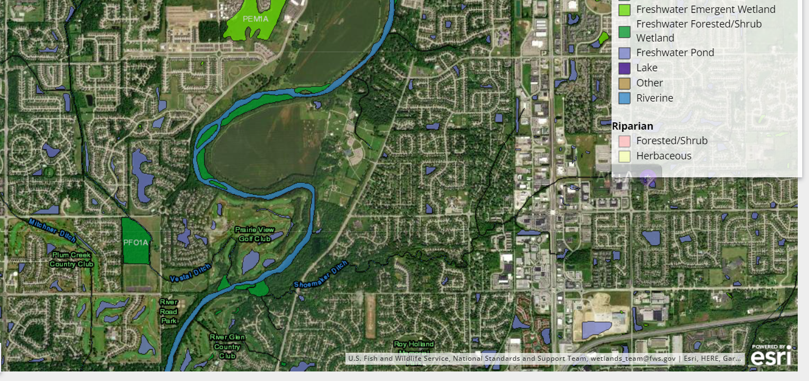
https://fwsprimary.wim.usgs.gov/wetlands/apps/wetlands-mapper/

Slide 14
The Future of 3D Hydrography Mapping at USGS
IGIC Geospatial Coordinators Forum
September 20, 2023

Slide 15
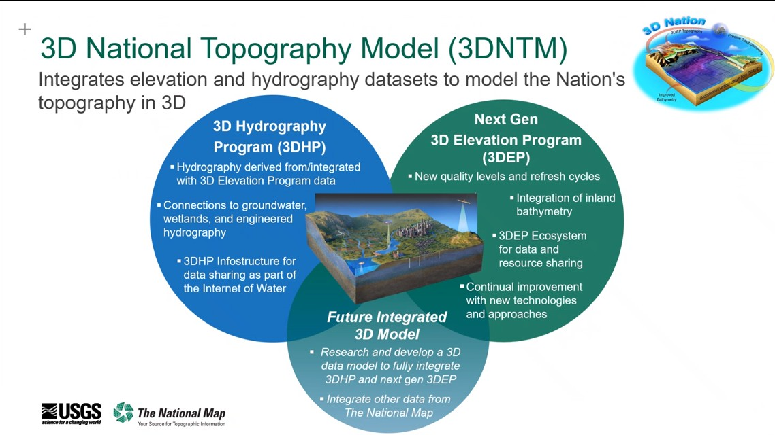

Slide 16
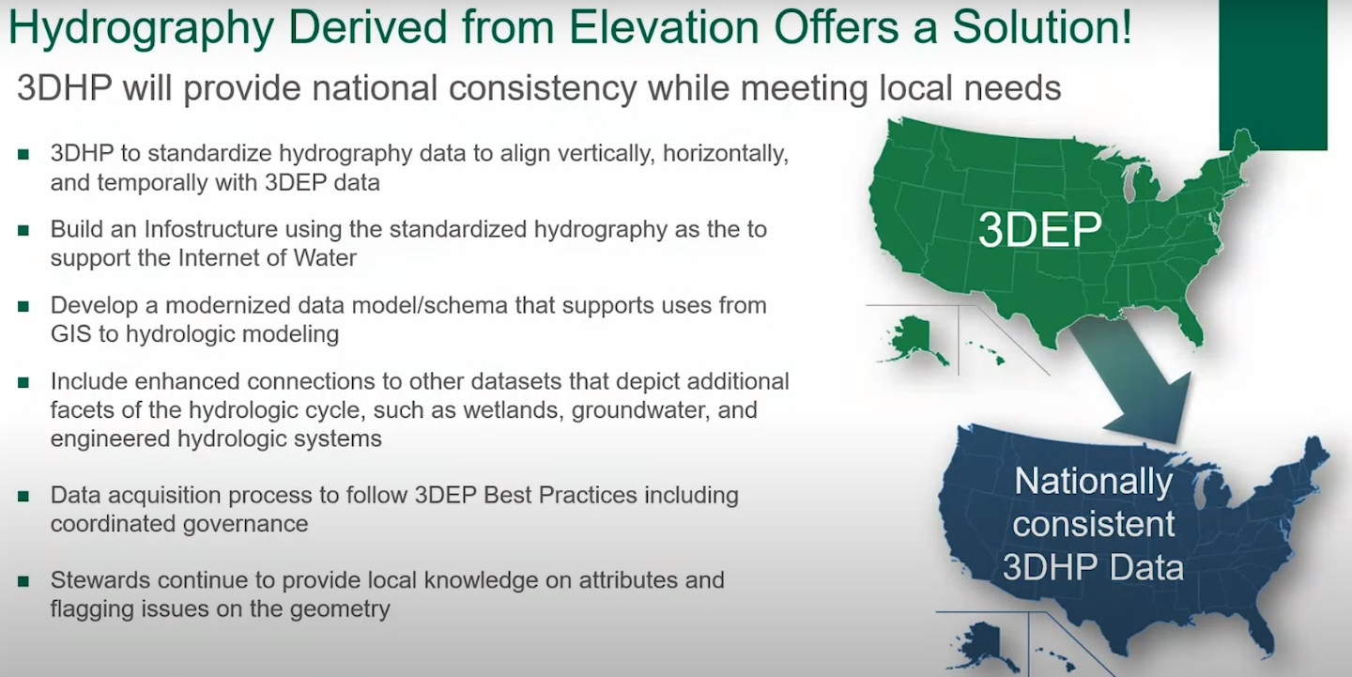

Slide 17
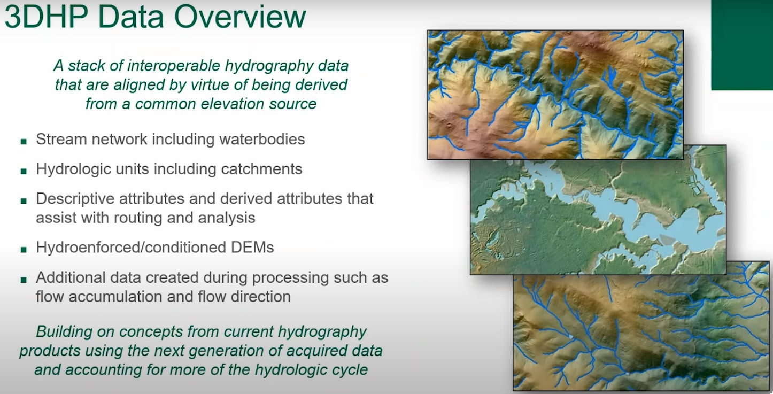

Slide 18
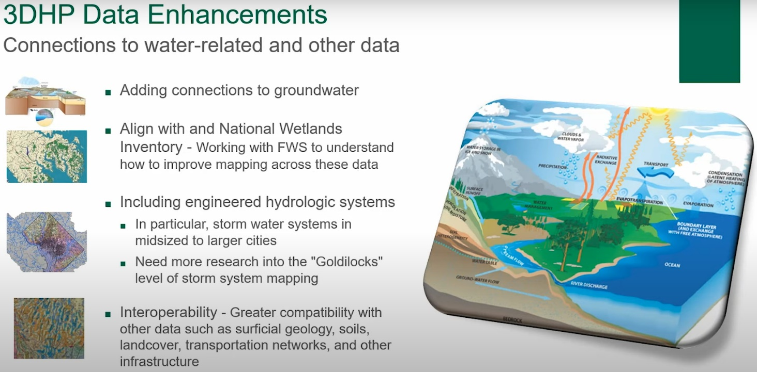

Slide 19
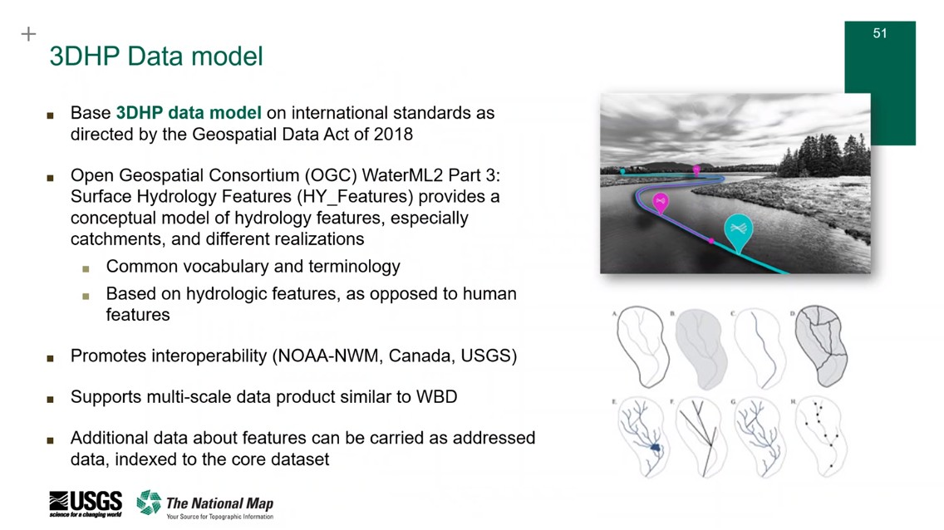

Slide 20
What is 3DHP
Elevation-Derived Hydrography (EDH)?
[LINK]
The EDH** stream network will be derived from 3DEP 1-meter Digital Elevation Models (DEMs)* with elevation values on each hydro line vertex to enable 3D analysis of the data.
        * Hydrologically enhanced raster DEMs created as a part of the stream network derivation process so that the flow of water across the surface is represented accurately
        ** The EDH stream network is derived from elevation surfaces to form a drainage network
The completed EDH stream network will be submitted by the County to the USGS to publish it in the 3DHP*** Dataset
*** The 3DHP Dataset will inherit key attributes of the NHD, WBD, and NHDPlus HR, but also will include new attributes and links to other data such as the NWI, groundwater, and engineered hydrologic systems like stormwater networks.
Notes:
3DHP Datasets will inherit key attributes of the NHD, WBD, and NHDPlus HR, but also will include new attributes and links to other data such as the NWI, groundwater, and engineered hydrologic systems like stormwater networks.

Slide 21
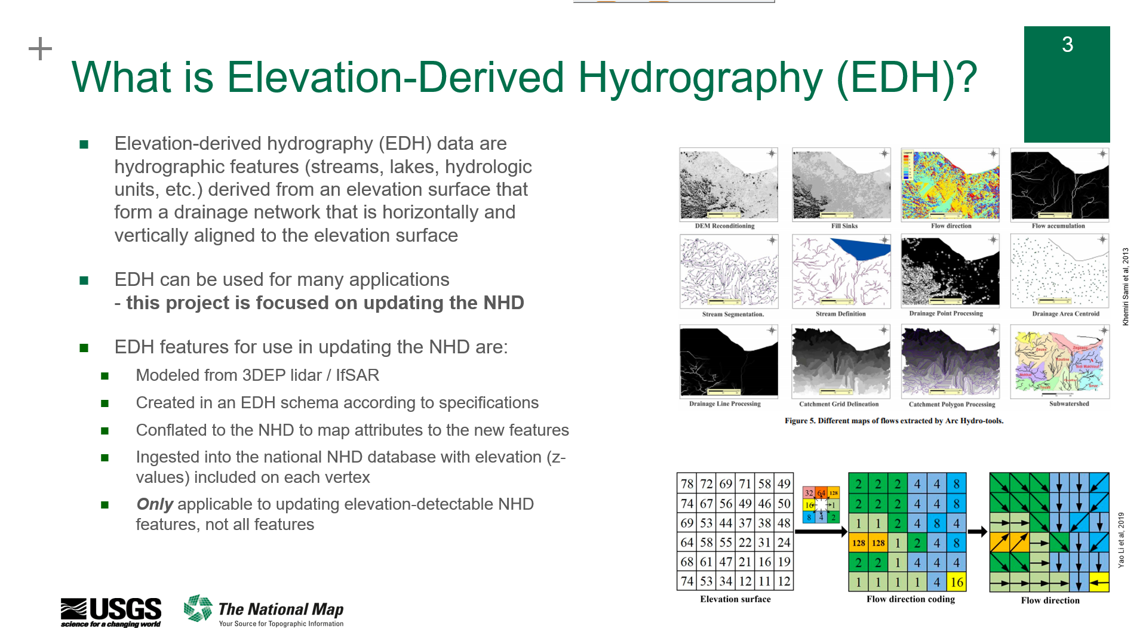

Slide 22
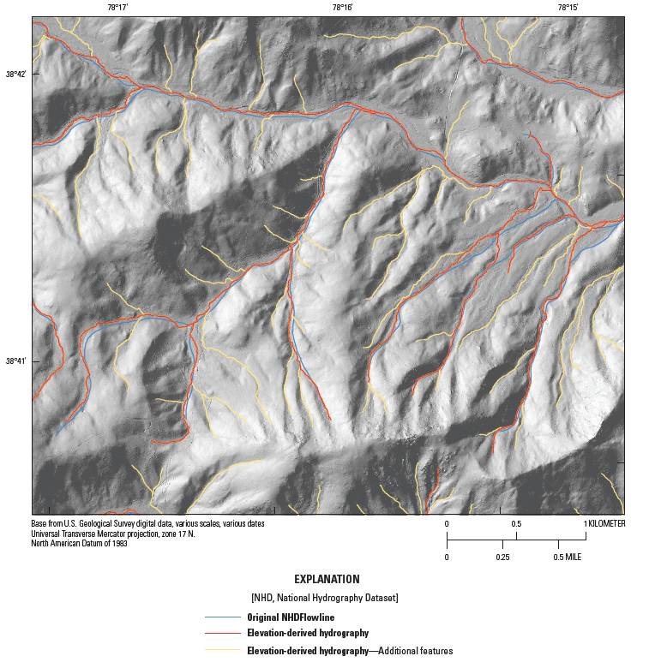
What is 3DHP
Elevation-Derived Hydrography (EDH)?
Notes:
3DHP Datasets will inherit key attributes of the NHD, WBD, and NHDPlus HR, but also will include new attributes and links to other data such as the NWI, groundwater, and engineered hydrologic systems like stormwater networks.

Slide 23
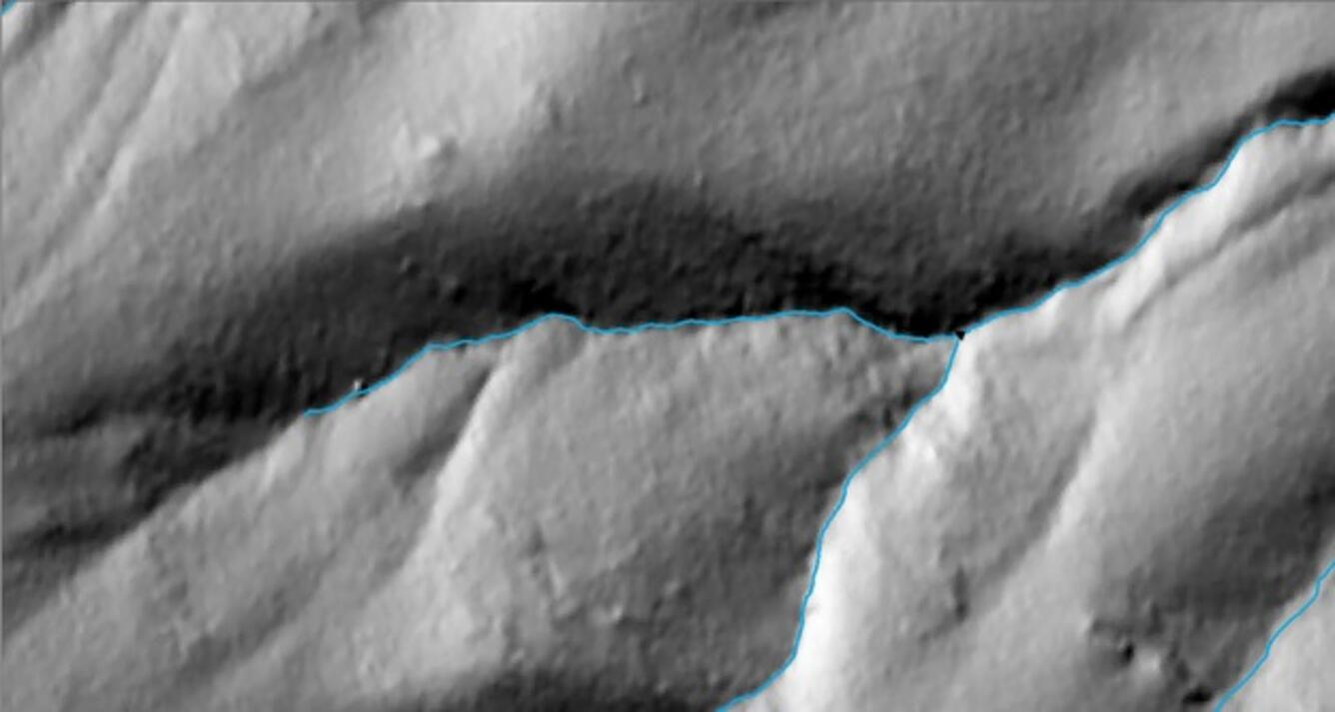
What is 3DHP
Elevation-Derived Hydrography (EDH)?
Lines up with hillshade valley:
Notes:
3DHP Datasets will inherit key attributes of the NHD, WBD, and NHDPlus HR, but also will include new attributes and links to other data such as the NWI, groundwater, and engineered hydrologic systems like stormwater networks.

Slide 24
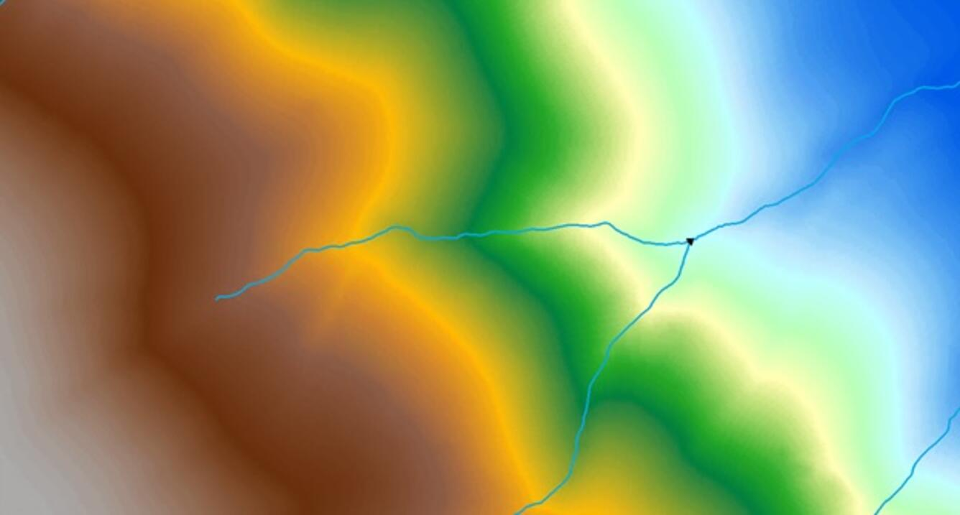
What is 3DHP
Elevation-Derived Hydrography (EDH)?
Follows contours of the elevation surface:
Notes:
3DHP Datasets will inherit key attributes of the NHD, WBD, and NHDPlus HR, but also will include new attributes and links to other data such as the NWI, groundwater, and engineered hydrologic systems like stormwater networks.

Slide 25
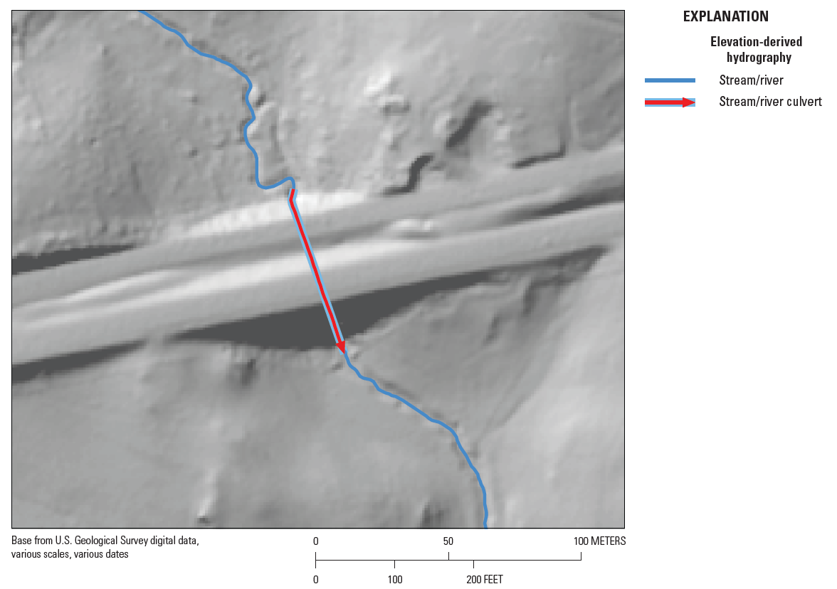
What is 3DHP
Elevation-Derived Hydrography (EDH)?
Notes:
3DHP Datasets will inherit key attributes of the NHD, WBD, and NHDPlus HR, but also will include new attributes and links to other data such as the NWI, groundwater, and engineered hydrologic systems like stormwater networks.

Slide 26
Benefit from adopting National 3D elevation and hydrography data standards that are also adopted by the State of Indiana GIO
integrated elevation and hydro data improves water resource management and provides more accurate modeling and monitoring of flooding, environmental, and engineered systems
expands data sharing opportunities and data maintenance / stewardship responsibilities across
Fed->State->County->City partners
provides geospatial connections/alignment to other water data systems and networks (e.g. NWI, legal drains, wellhead protection areas / ground water, farm tile drains, storm sewer systems, etc…)
opportunity to share in data development costs through the USGS DCA grant program
3DHP is estimated to provide more than $1 billion in annual benefits to Federal, State, Local, Tribal, Private, and Non-profit organizations every year
Summary of 3DNTM and Why Participate?
NEXT GEN GIS

Slide 27
Why Participate?
Enhancements included in the
3D Hydrography Program
Culverts
culvert data acquired during the process of deriving hydrography from elevation will be made available
Hydrologically enhanced elevation and other surfaces
Hydrologically enhanced raster DEMs will be created as a part of the stream network derivation process so that the flow of water across the surface is represented accurately. Additional derivative surfaces may be developed and provided as products as the program matures.
Stream network
The stream network will be derived from 3DEP 1-meter standard product digital elevation models (DEMs) created from lidar (5-meter DEMs from IfSAR in Alaska) and will include elevation values on each vertex to enable 3D analysis of the data.
Hydrologic units
Hydrologic units will be derived using the stream network and elevation data, while retaining and utilizing important outlet point information from the Watershed Boundary Dataset.
Addressed Data
3DHP will support a hydrographic addressing system such that data produced by users can be assigned a unique location on the network (similar to a street address) and shared across the user community
Wetlands Integration
Collaborative mapping of the stream network and the NWI will enable the two datasets to function together as a whole and to accurately depict the inland waters of the U.S.
Engineered Hydrologic Systems
3DHP will include information on engineered hydrologic systems, with a concerted effort to integrate connection points to, or generalized representations of, stormwater systems in urban areas.
Groundwater connections
Connection between surface and groundwater features will be supported, for example, by identifying gaining and losing stream reaches or providing estimates of groundwater contributions to streamflow, where known.
Topobathymetry
USGS is researching how to create a continuous topobathymetric surface derived from high-resolution elevation and bathymetry. Plans to operationalize inland bathymetry will be addressed in the next generation of 3DEP.

Slide 28
